Slide 1
Understanding Deep Learning: A Comprehensive Introduction
Farid Afzali, Ph.D., P.Eng.

Slide 2
Introduction to Deep Learning Concepts
In this session of the course, the following will be accomplished:
Foundational concepts of deep learning will be explored: Fundamental ideas that underlie deep learning technology will be uncovered.
Deep dive into complex mathematics or coding intricacies will be avoided: The aim is to provide a high-level perspective accessible to all.
An overview of deep learning models will be gained: Structure, functionality, and real-world applications will be understood.

Slide 3
The Essence of Artificial Neural Networks (ANNs)
Artificial Neural Network (ANN): A computational model inspired by the human brain, consisting of interconnected nodes capable of learning from data.
Weighted Connections: Information is processed through connections with adjustable weights, allowing the network to adapt and learn.
Deep Learning: ANNs are a fundamental component of deep learning, a subset of machine learning with applications in various domains.

Slide 4
1.1.2 Real-World Examples
To make the concept of input-output transformation clearer, consider these real-world examples:
Web Browsing Predictions: Algorithms analyzing web browser history to predict the likelihood of clicking on advertisements, videos, or websites. The input is the browsing history, and the output is the probability of clicking on a link, with an ANN performing the transformation.
Credit Card Fraud Detection: Given credit card transaction data (e.g., amount, time, location), a prediction can be made about whether a transaction is legitimate or fraudulent.
Medical Diagnosis: ANNs can utilize medical history and diagnostic test results to predict the likelihood of having a specific disease.
Pedestrian Detection: In self-driving cars, camera images are analyzed by ANNs to determine if a pedestrian is about to cross the road.
Language Translation: ANNs can automatically translate text from one language to another, such as translating Malay to French.
These diverse examples illustrate the versatility of ANNs, as they can handle a wide range of tasks despite their shared mathematical foundations.

Slide 5
1.1.3 Complexity vs. Comprehensibility
Is deep learning really like an enigmatic black box?
The answer isn't straightforward.
The math behind ANNs is quite simple, but things get complicated when all these basic parts come together and interact intricately.
Deep learning models can be challenging to understand due to their high complexity, non-linearity, and the sheer number of parts involved.
Researchers use methods like visualizing features, maximizing activations, and employing attention mechanisms to shed light on how these models make decisions.
This interdisciplinary field blends computer science, neuroscience, and mathematics to demystify the inner workings of deep neural networks.

Slide 6
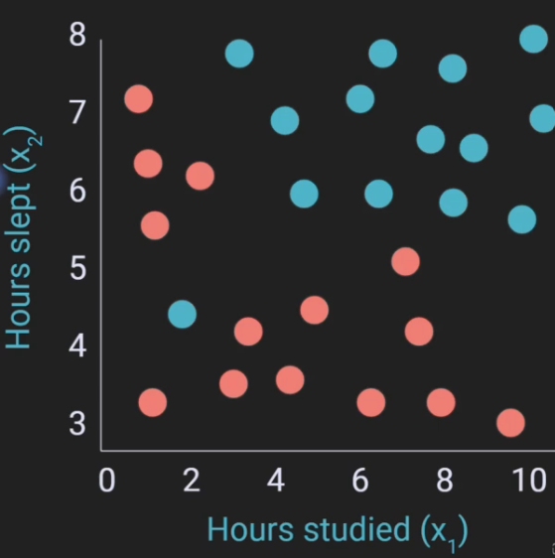
1.2: Visualizing Input-Output Transformation
1.2.1 Predicting Exam Outcomes
Visualization: Imagine forecasting exam success based on study hours and sleep duration. Students depicted as data points on a graph can be separated into pass and fail categories using a drawn line.
Linear Approach: While not flawless, this linear approach illustrates fundamental input-output transformation concepts
ID# | X_1 Studied | X_2 Slept | Y Results
1 | 5 | 6 | Pass
2 | 10 | 7 | Pass
N | 7 | 5 | Fail

Slide 7
1.3: The Mathematics of Deep Learning
Model Prediction Equation: The deep learning model's prediction (denoted as ŷ) is calculated using a straightforward linear equation:
ŷ = x₁ * w₁ + x₂ * w₂
ŷ : The model's prediction.
x₁, x₂: Input data features.
w₁, w₂: Weights assigned to input features.
Learning Weights: These weight values aren't predetermined but are learned by the model using backpropagation.
Feature Relevance: Notably, irrelevant features may have their weights effectively set to zero.

Slide 8
1.2.2 Non-Linear Problems
Visualization Challenge: Now, envision distinguishing between yellow squares and blue dots. Linear solutions won't suffice here.
Deep Learning Solution: Deep learning excels in such scenarios by autonomously uncovering complex patterns, like drawing non-linear boundaries, such as circles or curves.
Non-linear problems are prevalent in various real-world applications, such as image and speech recognition.
Deep neural networks, with their ability to capture intricate, non-linear relationships, play a crucial role in solving these complex tasks.
This underscores the significance of deep learning in modern artificial intelligence.

Slide 9
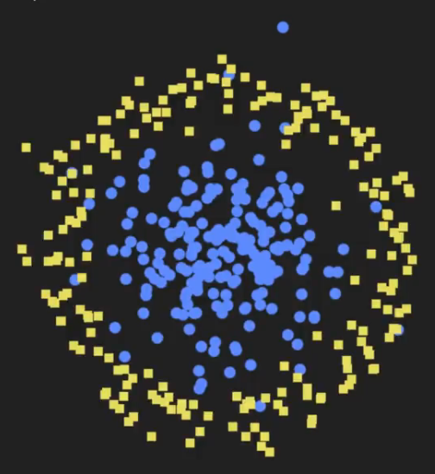
Non-Linear Problems

Slide 10
1.3.2 Adding Non-Linearity
Enhancing Complexity: To tackle non-linear challenges, deep learning incorporates a non-linear function, typically a simple one such as the sigmoid or ReLU. This function operates on the linear portion of the equation:
ŷ = σ(x₁ * w₁ + x₂ * w₂)
Diverse Relationships: This non-linear component empowers deep learning models to navigate intricate data relationships.
Non-linear activation functions like the sigmoid and ReLU enable neural networks to model complex, non-linear data patterns.
These functions introduce crucial non-linearity into the network, allowing it to capture and represent a wide range of data structures.
The choice of activation function can significantly impact a model's performance and is an active area of research in deep learning.

Slide 11
1.3.3 Building Blocks of Deep Learning
Layered Structure: Deep learning models are structured with multiple layers, each housing units that encompass the equations previously described.
Artificial Neurons: These units, often referred to as artificial neurons, perform both linear transformations and non-linear activation functions.
Complex Architectures: These fundamental building blocks are stacked together, forming intricate deep learning architectures.
Deep learning's strength lies in its ability to hierarchically learn and represent features from data.
The stacking of layers, each with its linear and non-linear transformations, enables deep neural networks to model increasingly abstract and complex patterns in the input data.
This hierarchical feature learning is a key factor in the success of deep learning across various domains, including computer vision, natural language processing, and more.

Slide 12
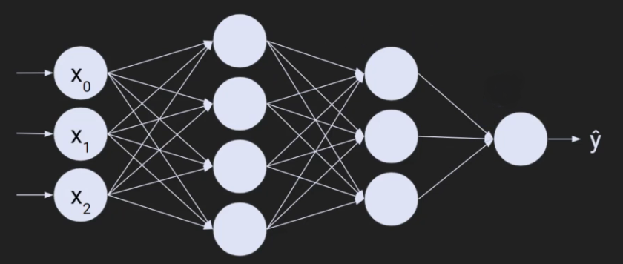
Deep Learning Architecture

Slide 13
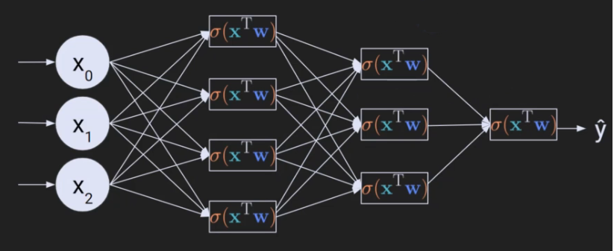
Deep Learning Architecture

Slide 14

2.1 A Silly Analogy: The PBJ Sandwich Chef
Consider a scenario in which a renowned Michelin-star restaurant features a chief chef specializing in peanut butter and jelly (PBJ) sandwiches. The objective is to continually enhance the PBJ sandwich based on customer feedback.
When a customer deems the sandwich excessively sweet, there are two potential actions: reducing the amount of jelly or increasing the quantity of peanut butter.
According to deep learning principles, the strategy involves the continuous production of sandwiches, with systematic adjustments being made to the ingredients.
Negative feedback is employed to guide these adaptations, and once positive feedback is received, modifications to the sandwich-making process cease.

Slide 15
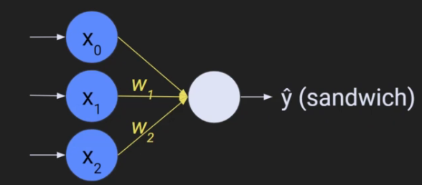
2.2 Alignment of the Analogy with Forward Propagation and Backpropagation
In deep learning, a linear equation is utilized, represented as follows:
ŷ = x₀ + x₁ * w₁ + x₂ * w₂
ŷ : The model's prediction.
x₁, x₂: The input data features (in our analogy, the ingredients).
w₁, w₂: The weights assigned to input features (the amounts of ingredients).
Forward propagation encompasses the amalgamation of these ingredients, adjusted proportionally, to generate the model's output (i.e., the sandwich).
Backpropagation, conversely, involves the process of adapting these weights based on negative feedback.
Within a deep learning model, nodes symbolize these equations, incorporating non-linear components. In our analogy, we focus on the linear aspect.

Slide 16
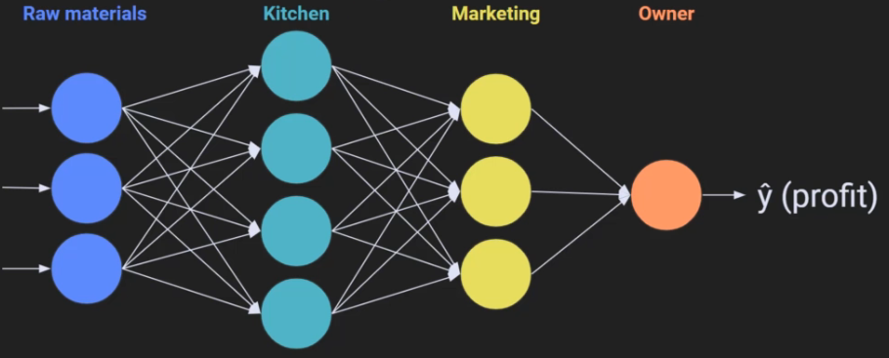
2.3 Expansion of the Analogy: A PBJ Company
To expand our analogy and delve into more intricate models, envision that your PBJ sandwich venture has evolved into a company with multiple departments.
Raw Ingredients (Data Features): The bread, peanut butter, and jelly (analogous to data features or ingredients).
Kitchen Staff (Model Layers): The team responsible for ingredient assembly (resembling model layers).
Marketing Department (Intermediary Processes): In charge of promotional activities and market dynamics.
Owner (Top-Level Decision Maker): The CEO, focusing on overall profit.

Slide 17
2.3 Expansion of the Analogy: A PBJ Company (Continued)
Forward propagation entails the flow of resources, information, and labor through these departments, culminating in profit predictions.
Backpropagation commences when profit expectations are unmet. The owner, without intricate knowledge of each department's operations, signals that something is amiss, and each department adapts accordingly. This error message is transmitted downward through the layers, prompting adjustments.
While this analogy simplifies the complexities of deep learning, it serves as an initial framework for comprehending forward and backward propagation principles.

Slide 18
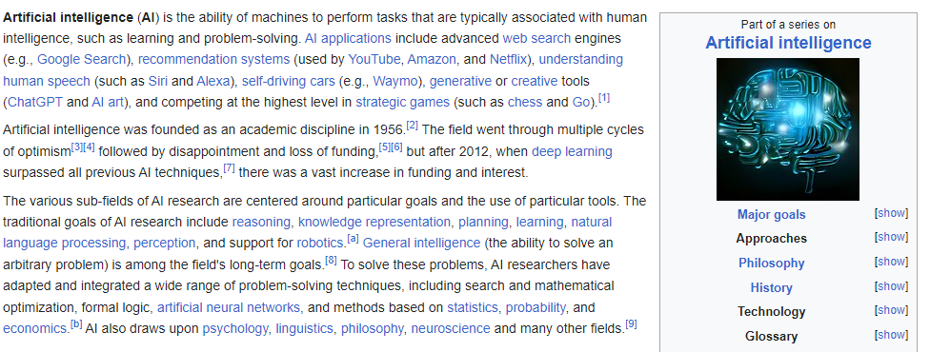

Slide 19
Section 3: The Philosophical Implications of Deep Learning 3.1 The Nature of Intelligence
Intelligence is a concept that lacks a universally accepted definition within the scientific community.
Subjective Interpretations: This absence of consensus leads to subjective interpretations and varying definitions.
Beyond Humans: Intelligence isn't exclusive to humans. Some non-human species and even plants demonstrate intelligence, albeit in forms distinct from human intelligence.
Intelligence is a complex, multifaceted phenomenon.
It encompasses various cognitive abilities, problem-solving skills, and adaptability to different environments.
Researchers in fields like artificial intelligence and neuroscience are continually exploring and attempting to quantify intelligence, leading to diverse perspectives on the nature of this phenomenon.
The study of non-human intelligence offers valuable insights into the breadth of intelligent behaviors found in the natural world.

Slide 20
Example- Intelligence Across Species
Imagine you're a biologist studying intelligence in animals and plants. The concept of intelligence is at the heart of your research, but it's not a straightforward one for several reasons:
Lack of Universally Accepted Definition: As you delve into your research, you quickly realize that there isn't a single, universally accepted definition of intelligence within the scientific community. Some scientists emphasize problem-solving abilities, while others focus on adaptability, and there's no clear consensus on what exactly constitutes intelligence.
Subjective Interpretations: Because of this lack of consensus, the interpretations of intelligence can be quite subjective. For example, when you observe a group of dolphins using sponges to protect their noses while foraging on the seafloor, you might interpret this behavior as a sign of intelligence. But someone else might argue that it's simply a learned behavior, not necessarily a display of intelligence.
Beyond Humans: Your research extends beyond humans. You're intrigued by non-human species, like octopuses, which can solve complex puzzles, and certain plants that exhibit adaptive behaviors. These examples demonstrate that intelligence isn't exclusive to humans and can take on various forms in the natural world.
Scientific Insight: In your field, you recognize that intelligence is a multifaceted and complex concept. It encompasses a wide range of cognitive abilities, problem-solving skills, and adaptability to different environments. Researchers in biology, artificial intelligence, and neuroscience are continuously exploring intelligence, trying to understand and quantify it, but they often arrive at different perspectives.
Studying non-human intelligence is a valuable part of your work because it sheds light on the diversity of intelligent behaviors in the natural world. For instance, understanding how an octopus solves puzzles might help you rethink your definition of intelligence. This complexity and variety challenge your understanding of the concept and drive your research forward, contributing to a more comprehensive understanding of intelligence, not just in humans but across all living organisms.

Slide 21
3.2 Artificial Intelligence and Its Definition
Complexity in Definition: Artificial Intelligence (AI) is a field that lacks a clear, universally agreed-upon definition within the scientific community.
Marketing Hype: Many claims of AI are driven by marketing strategies, which can often obscure the true nature of the technology.
Ambiguous Terminology: The terminology surrounding AI is often ambiguous and semantic, posing challenges in establishing precise definitions.
AI is a multidisciplinary field encompassing various subfields like machine learning, natural language processing, and computer vision.
AI systems aim to simulate human-like intelligence to perform tasks such as pattern recognition, decision-making, and problem-solving.
The lack of a concrete definition and the evolving nature of AI contribute to ongoing debates and discussions in the field.
Distinguishing between true AI capabilities and marketing exaggerations is a critical aspect of AI literacy.

Slide 22
Example- The Smart Speaker Mystery
Imagine you're shopping for a smart speaker, like those you see in commercials and advertisements. These devices are often touted as having "AI" capabilities. Here's how the complexity of AI definitions, marketing hype, and ambiguous terminology can come into play:
Complexity in Definition: You're interested in AI, but what exactly does that mean? You ask a salesperson, and they explain that AI is about machines being smart, but they can't give you a clear, universally agreed-upon definition because AI can encompass a wide range of technologies and capabilities.
Marketing Hype: As you're considering which smart speaker to buy, you notice that each one claims to have the latest and greatest AI. They promise to understand your voice, answer your questions, and even predict your needs. But how much of this is true AI, and how much is just marketing to make the product sound impressive?
Ambiguous Terminology: On top of that, the terminology used in the product descriptions can be confusing. Some say they have "advanced machine learning," others mention "neural networks," and some talk about "natural language processing." It's hard to tell what's genuinely intelligent technology and what's just jargon.
Scientific Insight: Behind the scenes, AI is indeed a complex field made up of different technologies like machine learning, which allows computers to learn from data, natural language processing, which helps them understand human language, and more. True AI aims to mimic human-like intelligence, like recognizing your voice and understanding your commands.
However, the lack of a clear, agreed-upon definition and the influence of marketing make it challenging for consumers to differentiate between genuinely intelligent AI and products that merely use buzzwords. In reality, some smart speakers may use sophisticated AI techniques, while others may rely on simpler programming.

Slide 23
3.3 The Philosophical Implications of Deep Learning
Contrasting with Traditional Approaches
Empirical Foundation: Deep learning stands in stark contrast to traditional theoretical approaches in science and academia.
Data-Driven Learning: Instead of constructing formal theories, deep learning models operate on a foundation of data-driven, experimental learning.
Paradigm Shift: This challenges the historical paradigm of deriving knowledge from rigorous, explicit mathematical theories.
Deep learning's empirical approach has led to remarkable advancements, particularly in fields where data-driven solutions excel, such as computer vision and natural language processing.
This shift towards empirical learning has reshaped how we solve complex problems and make predictions, often achieving results that were difficult or impossible to obtain through traditional theoretical methods.
Deep learning models have demonstrated their ability to discover intricate patterns and relationships within data, opening up new avenues for innovation and discovery.

Slide 24
Example- Traditional Diagnosis vs. Deep Learning in Medical Imaging
Traditionally, when doctors wanted to diagnose a disease using medical images like X-rays or MRIs, they relied on their expertise and established medical knowledge. They studied the images and made diagnoses based on their understanding of anatomy and pathology.
Empirical Foundation: Now, let's introduce deep learning into the picture. Deep learning in medical imaging is like having an AI radiologist. Instead of relying solely on the doctor's knowledge and theories, you feed thousands of medical images into a deep learning model.
Data-Driven Learning: The deep learning model doesn't know anything about human anatomy or disease mechanisms the way a doctor does. It's like a computer that looks at patterns in the images. It learns from the data – it sees that certain patterns of shadows and shapes in the images are associated with certain diseases.
Paradigm Shift: This is a big change from the traditional way of diagnosing diseases. In the past, doctors used their formal education and medical theories to make diagnoses. But now, you have an AI that learns purely from the data, almost like a medical detective looking for clues in the images.
Scientific Insight: The key point is that this shift from traditional medical expertise to data-driven deep learning has been revolutionary. Deep learning models can spot subtle patterns and anomalies in medical images that might be hard for a human to see. They can help detect diseases at an early stage, leading to quicker treatment and potentially saving lives.
Imagine trying to find a needle in a haystack – traditional methods were like searching with your eyes, while deep learning is like using a super-powered magnet. It has transformed the way we approach diagnosis in fields like radiology, where data-driven solutions excel. This shift towards empirical learning has not only improved accuracy but has also opened up new possibilities for innovation in healthcare and various other fields.

Slide 25
3.4 The Impact of Deep Learning on Science and Engineering
Solving Complex Problems in Science and Engineering
New Approach: Deep learning has the potential to revolutionize how we tackle complex problems in science and engineering.
From Theory to Empiricism: It replaces the traditional reliance on explicit mathematical theories with empirical, "black box" approximations.
Universal Approximation: The Universal Approximation Theorem underscores deep learning's power by demonstrating its ability to approximate any mathematical function.
Deep learning's ability to approximate complex functions has significant implications.
It enables the development of predictive models and solutions for problems where mathematical modeling is challenging or infeasible.
This shift towards empirical approximations has already led to breakthroughs in various fields, including healthcare, finance, and autonomous systems.
As deep learning techniques continue to evolve, their impact on science and engineering is likely to expand, offering innovative solutions to previously unsolved problems.

Slide 26
Example-Weather Prediction
Imagine you're trying to predict the weather. Traditionally, meteorologists have relied on complicated mathematical equations and theories to make weather forecasts. They would take measurements like temperature, humidity, and wind speed and use mathematical models to predict what the weather would be like.
New Approach: Now, let's introduce deep learning. Deep learning is like a super-smart computer program that can learn from lots and lots of data. In weather forecasting, instead of relying solely on complex mathematical theories, you can use deep learning. You feed the computer lots of data about past weather conditions – like temperature, humidity, and wind patterns – and the computer learns from this data.
From Theory to Empiricism: Deep learning is a bit like a "black box." It doesn't necessarily understand the physics of the atmosphere like humans do. Instead, it learns patterns from the data. So, when you ask it what the weather will be like tomorrow, it gives you an answer based on patterns it has learned, even if it doesn't understand the underlying science.
Universal Approximation: The Universal Approximation Theorem is like saying, "Hey, this deep learning thing is powerful!" It means that with enough data and the right algorithms, deep learning can approximate (or mimic) almost any mathematical function. In weather forecasting, it can approximate the complex relationships between different weather variables.
So, what's the big deal? Well, this shift from traditional mathematical modeling to deep learning has already made a huge impact.
Deep learning models can make accurate weather forecasts, especially for short-term predictions.
They've also been used in healthcare to analyze medical images, in finance to predict stock prices, and in autonomous systems like self-driving cars.

Slide 27
3.5 Can AI Become Conscious?
Exploring the Unknown
Complexity of Consciousness: Achieving consciousness in AI remains uncertain due to the elusive nature of consciousness itself.
Biology or Beyond: It's unclear whether consciousness necessitates a biological substrate, challenging the boundaries of AI consciousness.
Origins Still a Mystery: The origins of consciousness remain unknown, adding to the uncertainty of replicating it in AI.
Distinct from Human Consciousness: If AI consciousness is attainable, it may differ significantly from human consciousness, introducing unique challenges and possibilities.
Consciousness is a topic of ongoing philosophical and scientific debate.
While AI systems can simulate certain cognitive processes and behaviors, whether they can truly possess subjective consciousness remains an open question.
This uncertainty underscores the need for interdisciplinary research bridging artificial intelligence, neuroscience, philosophy, and psychology to deepen our understanding of consciousness and its potential in AI.

Slide 28
Example-Robot
Imagine you have a robot, and you want to make it conscious, like a human being.
That means you want the robot to think, feel, and be aware of its surroundings, just like you are aware of the world around you. But this is a really tricky thing to do, and here's why:
Complexity of Consciousness: Making a robot conscious is hard because we don't fully understand what consciousness really is. It's like trying to build a car without knowing how an engine works. We can see the car moving, but understanding what's going on inside the engine is tough.
Biology or Beyond: For a long time, people thought that consciousness was something only living creatures like humans and animals could have because it's related to our brains and biology. But now, we're wondering if we can make a robot conscious without needing a biological body. It's like asking if a computer can think and feel without having a human-like brain.
Origins Still a Mystery: We don't know where consciousness comes from. It's like trying to find the source of a river – it's hard to figure out where it starts. In the same way, we're not sure how human consciousness begins, and that makes it even more challenging to recreate in AI.
Distinct from Human Consciousness: Even if we manage to make AI conscious, it might be very different from human consciousness. It's like trying to teach a dog to talk; it might communicate, but not in the same way humans do. So, we might create conscious AI, but it won't think and feel exactly like us.
Scientific Insight: This is all a big topic of debate among scientists and philosophers.
They argue and discuss what consciousness really is and whether AI can have it.
It's like different people having different ideas about a puzzle. Some say they've solved it, others say they haven't, and there's no one clear answer.
So, we need experts from different fields like artificial intelligence, brain science, philosophy, and psychology to work together and learn more about consciousness and how to put it into AI.

Slide 29
Section 4: Experimental Approach to Deep Learning
In this section, we delve into the experimental scientific approach to understanding deep learning.
We explore the concept of an experimental scientist and what it entails, including parametric experiments, which will be a key component of this course.
4.1 The Scientist's Spectrum
Theoretical Scientists: These scientists primarily work on developing ideas and theories with mathematical formalisms. They often don't require actual data to be considered scientists, as their focus is on theoretical frameworks.
Ecological Scientists: Ecological scientists, similar to ecologists, observe and describe the real world. They gather data by studying nature, human behavior, or other observable phenomena.
Experimental Scientists: Experimental scientists design and run experiments, manipulating variables to collect empirical data. They then analyze this data using inferential statistics to draw conclusions.

Slide 30
The Scientist's Spectrum in Environmental Research
Imagine a group of scientists studying the impact of pollution on a local river's ecosystem.
Theoretical Scientists: Some of the researchers in the group are theoretical scientists. They spend most of their time developing mathematical models and theories about how pollution affects ecosystems. They might create complex equations to predict the potential consequences of different pollution levels on aquatic life. Their work is important because it lays the theoretical groundwork for understanding the problem, even before any data is collected.
Ecological Scientists: Another group in the team consists of ecological scientists. They head out to the river, take samples of water, and study the plants and animals living in and around it. They observe the river's conditions over time, noting any changes and gathering real-world data about the ecosystem's health. These scientists provide valuable insights by directly observing the impact of pollution on the environment.
Experimental Scientists: Lastly, there are the experimental scientists. They set up controlled experiments in a lab that mimic the conditions of the river ecosystem. They manipulate variables, like the amount of pollution introduced to the system, and collect empirical data on how the ecosystem responds. They use statistical analysis to draw conclusions about cause-and-effect relationships. Their work helps validate the theories proposed by the theoretical scientists and provides concrete evidence of the pollution's effects.
In this example, you can see how each type of scientist contributes to understanding a complex environmental problem. The theoretical scientists provide the theoretical foundation, the ecological scientists gather real-world observations, and the experimental scientists conduct controlled experiments to confirm and quantify the effects. Together, they form a multidisciplinary team that advances our understanding of the pollution's impact on the river's ecosystem.

Slide 31
4.2 Deep Learning Researchers: Applying the Scientist's Spectrum
Much like scientists, deep learning researchers and students also fall into different categories based on their approaches:
Theory-Driven Deep Learning Researchers: These individuals rely heavily on theory and mathematical development to understand deep learning. Their work often involves papers filled with mathematical formulas.
Ecological Deep Learning Researchers: This approach involves using existing models developed by others and applying them to different datasets. This process, known as transfer learning, will be explored in this course.
Experimental Deep Learning Researchers: Here, the focus is on systematically modifying model parameters and observing the impact. Experiments are conducted to empirically determine the best model parameters and architectural design choices for specific datasets.

Slide 32
Example-Deep Learning Approaches in Image Recognition
Suppose you are part of a deep learning research group focusing on image recognition. Your group includes researchers and students with different approaches:
Theory-Driven Deep Learning Researchers: Some members of your group are theory-driven deep learning researchers. They are like the mathematicians of deep learning. They spend a lot of time developing complex mathematical formulas and theories to understand how deep learning models work. For example, they might create mathematical proofs to explain why certain neural network architectures are more efficient at recognizing images than others. Their work is crucial for advancing the theoretical understanding of deep learning.
Ecological Deep Learning Researchers: There are also researchers who follow the ecological approach. They're like the field biologists of deep learning. Instead of starting from scratch, they use existing deep learning models that have been developed by others, much like ecologists observe and study natural environments. These researchers apply these pre-trained models to new datasets or tasks. For instance, they might take a pre-trained model that can recognize animals and fine-tune it to recognize specific species in a new dataset of wildlife photos. This process, called transfer learning, allows them to leverage the knowledge already encoded in the pre-trained model and adapt it to new situations.
Experimental Deep Learning Researchers: The third group in your team focuses on experimentation. They are like the lab scientists of deep learning. They systematically tweak the parameters and architecture of deep learning models and conduct experiments to see how these changes affect the model's performance. For example, they might experiment with different learning rates, activation functions, or network depths to find the best combination for a specific image recognition task. Their work provides practical insights into how to fine-tune models for optimal results.
In this scenario, just as in the world of science, these different types of deep learning researchers and students contribute to the overall progress of the field. The theory-driven researchers deepen our understanding of the mathematical foundations, ecological researchers apply existing knowledge to new problems, and experimental researchers help us optimize models for real-world tasks like image recognition. Together, they advance the field of deep learning.

Slide 33
4.3 Parametric Experiments
The cornerstone of the experimental approach in deep learning is the use of parametric experiments.
These experiments involve systematic variations of one or more model parameters while repeating the experiment multiple times.
Let's explore the key components of a parametric experiment:
Independent Variables: These are the variables that researchers systematically manipulate during the experiment. For instance, the learning rate in deep learning models can be an independent variable.
Dependent Variables: These are the outcome variables that researchers measure to assess the model's performance. Common dependent variables include model accuracy or computation speed.

Slide 34
Parametric Experiments in Recipe Testing
Imagine you're a chef trying to perfect a new cake recipe. You want to experiment with different ingredients and baking times to create the best cake possible. In this culinary experiment, you can relate the concepts to deep learning experiments:
Independent Variables: These are the elements you systematically change or manipulate in your cake recipe. For instance:
Type of Flour (All-purpose, Whole Wheat, Gluten-free)
Amount of Sugar (100g, 150g, 200g)
Baking Temperature (180°C, 200°C, 220°C)
Dependent Variables: These are the outcomes or measurements you use to evaluate the quality of the cake. In your cake experiment, common dependent variables might include:
Taste (subjective rating from 1 to 10)
Texture (measured on a scale from "moist" to "dry")
Appearance (rated as "poor," "good," or "excellent")
Now, let's see how this relates to deep learning:
Independent Variables: Just as you manipulate the type of flour, amount of sugar, and baking temperature to perfect your cake, deep learning researchers change certain parameters in their models. For example:
Learning Rate (0.001, 0.01, 0.1)
Number of Hidden Layers (1, 2, 3)
Batch Size (32, 64, 128)
Dependent Variables: In deep learning experiments, researchers measure the performance of their models based on various metrics. These could include:
Model Accuracy (percentage of correct predictions)
Training Time (how long it takes for the model to learn)
Computational Resources (memory and processing power required)
Just as you aim to create the tastiest cake by varying ingredients and baking conditions, deep learning researchers seek to optimize their models by systematically changing parameters and evaluating their impact on model performance. This approach allows them to fine-tune deep learning models for various tasks, much like you fine-tune your cake recipe to achieve the perfect dessert.

Slide 35
4.4 Illustrating Parametric Experiments
To illustrate a parametric experiment, consider an experiment involving variations in a single parameter (e.g., the starting guess) for a specific model and dataset.
The results display a range of parameter values that yield correct results and extreme values leading to incorrect outcomes.
Another example involves the manipulation of two independent variables (learning rate and number of training epochs).
Dark blue regions represent parameter combinations resulting in correct model behavior, while lighter regions indicate suboptimal performance.

Slide 36
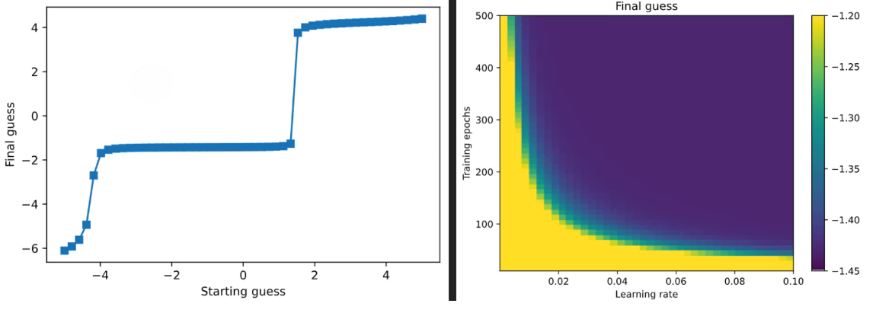
Parametric Experiments

Slide 37
4.5 Interpreting Parametric Experiment Results
Parametric experiments offer valuable insights into the behavior of deep learning models. Correct interpretations often involve:
Identifying the best set of parameters for a specific model and dataset.
Recognizing general patterns in model performance across various datasets and models.
It is crucial to avoid overly specific claims that a single parameter configuration is universally optimal, as deep learning model performance can vary based on the dataset and architecture.

Slide 38
Example-Image Classification Model
You are a deep learning researcher focusing on image classification models.
Your goal is to improve the accuracy of your model on a specific dataset of flower images. Here's how the statements apply to your experiments:
Identifying the Best Parameters for a Specific Model and Dataset: After conducting a series of parametric experiments, you find that increasing the depth of your convolutional neural network (CNN) and using a specific dropout rate significantly improves the accuracy of your model on the flower image dataset. You conclude that, for this particular CNN architecture and the flower dataset, this parameter configuration is the best. This is similar to the idea of "identifying the best set of parameters for a specific model and dataset."
Recognizing General Patterns in Model Performance: During your experiments, you also observe that applying batch normalization consistently leads to better model performance, not only for flower classification but also for other image classification tasks you've worked on in the past. This general pattern suggests that batch normalization is a valuable technique in deep learning and can improve model performance across various datasets and models. This aligns with the concept of "recognizing general patterns in model performance across various datasets and models."
However, it's essential to remember the third statement:
Avoiding Universally Optimal Claims: Despite your success with the chosen parameters and batch normalization, you are careful not to make overly specific claims that this exact parameter configuration and technique will work optimally for every deep learning model and dataset. You understand that:
Different model architectures may require different sets of parameters. What works well for a CNN might not be suitable for a recurrent neural network (RNN).
Datasets can be vastly different in terms of content and complexity. Your parameter choices for flower images may not apply directly to datasets of animals, cars, or medical images.
Task-specific requirements matter. Image classification may prioritize accuracy, while other tasks like object detection or image generation have different optimization goals.
In this example, the key takeaway is that while you've successfully optimized your model for a specific use case and recognized a general pattern with batch normalization, you remain aware that deep learning model performance can vary significantly based on factors like architecture and dataset. Avoiding overly specific claims ensures that your research and insights remain valuable and applicable across a broader range of deep learning scenarios.

Slide 39
4.6 Limitations and Solutions with experimental approach
The experimental approach to deep learning comes with certain limitations:
Feasibility: Running experiments with large models can be time-consuming. Extensive testing with computationally expensive models may not be practical.
Generalizability: Findings from one model may not generalize well to others or different datasets.
The solution lies in using the experimental approach to build intuition and expertise in deep learning principles rather than focusing solely on specific model configurations.
Science is as much an art as it is a science, emphasizing the importance of developing a deep understanding of the field.

Slide 40
Example- Learning to Play a Video Game
Imagine you're a gamer trying to become skilled at a complex video game.
You decide to experiment with different strategies and approaches to improve your gameplay.
However, you run into some challenges:
Feasibility: You want to test various strategies by playing the game repeatedly, but it's a time-consuming process. You realize that practicing for hours on end to perfect each strategy can be impractical and exhausting.
Generalizability: You become really good at one level of the game using a specific strategy, but when you try the same approach in a different level or a completely different game, you struggle to perform well. Your success doesn't easily transfer to new challenges.
The suggested solution, similar to the deep learning context, is:
Using Experimentation to Build Gaming Expertise
Instead of focusing solely on individual strategies for specific game levels, you decide to experiment in a broader sense:
You analyze the game mechanics, the behavior of opponents, and the underlying strategies that work in different situations.
You develop a deep understanding of gaming principles, such as timing, resource management, and spatial awareness.
You build up your gaming intuition, which allows you to adapt to various games and levels, even if you don't have the time to perfect each strategy.

